Slide 1
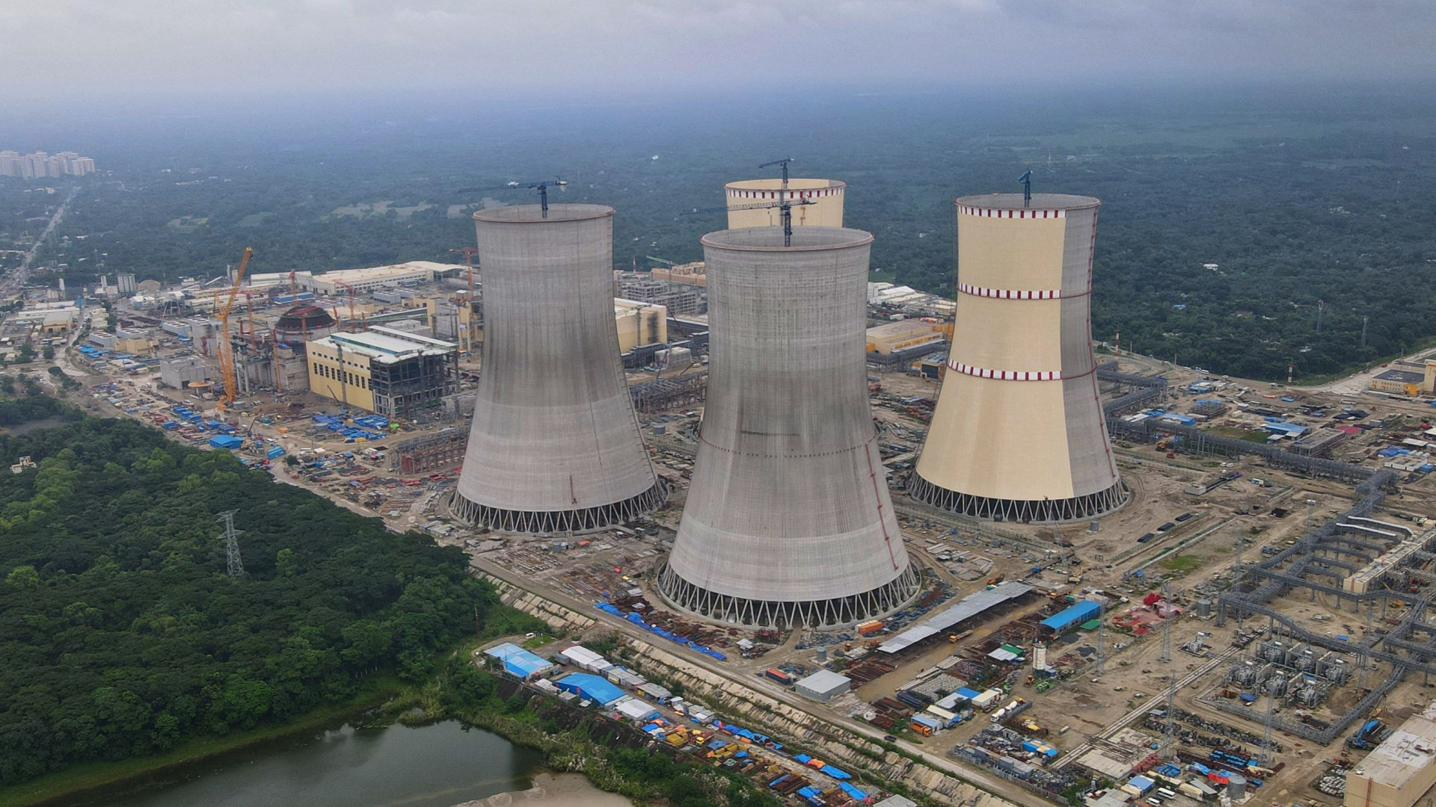
Welcome To Our Presentation

Slide 2
Topic: Environmental impact assessment of Rooppur Nuclear Power Plant

Slide 3
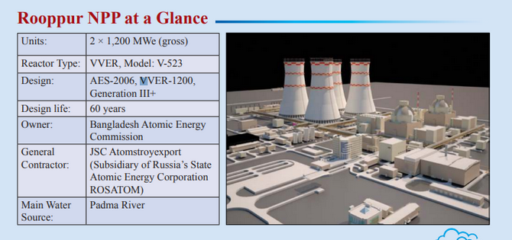
Rooppur Nuclear Power Plant
The Rooppur Nuclear Power Plant is a 2.4 GWe nuclear power plant project in Bangladesh.
The nuclear power plant is being constructed at Rooppur of Ishwardi Upazila on the bank of the river Padma, about 160 km northwest of Dhaka.
It will be the country's first nuclear power plant, and the first of the two units is expected to go into operation in 2025

Slide 4
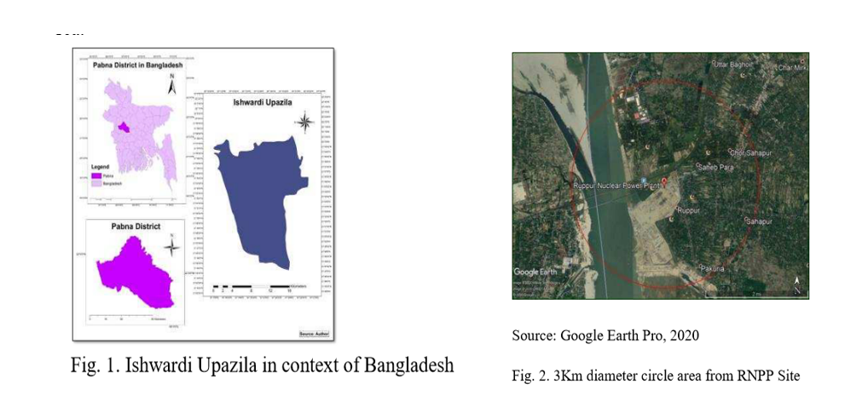
Study Area: Rooppur Nuclear Power Plant, Ishwardi, Bangladesh

Slide 5
Data Collection:
Field observations, household surveys, FGD, and key informant interviews were used to obtain primary data. Office personnel, informed local residents, including community members, merchants, teachers, and political leaders, were questioned to ascertain their perceptions of the project's social and environmental consequences. 3 km circular area at surrounding Rooppur Nuclear Power Plant is selected as the study area for this research. Secondary data were collected from different sources such as web browsing, daily newspapers, official documents, journal articles, photos, reports and so on
Data Sources:
Primary Data: Collected through direct surveys and monitoring efforts conducted by soil and environmental students and field personnel.
Secondary Data: Obtained from government reports, scientific publications, satellite imagery databases (NASA, NOAA), and environmental agencies such as the Bangladesh Department of Environment (DoE) and the Bangladesh Atomic Energy Commission (BAEC)

Slide 6
Environmental Impacts
Ecological Impacts
Societal Impacts
Impacts of Rooppur Nuclear Power Plant
Wildlife Impacts
Health Impacts
Cultural Impacts
Air Quality
Water Quality

Slide 7
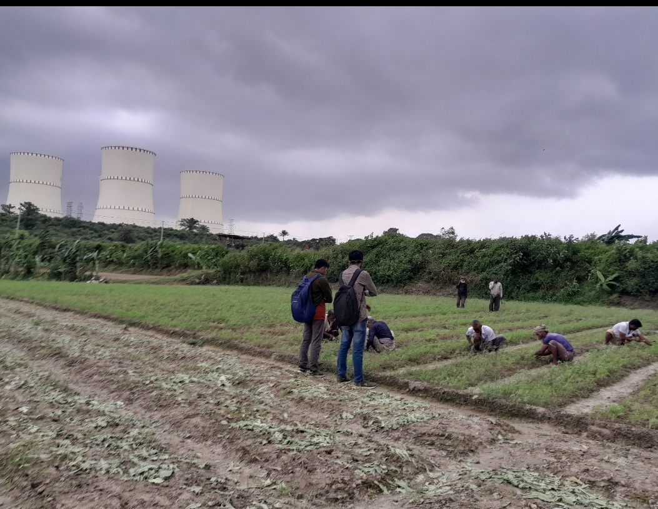
Environmental Impacts
Positive impact:
reduce greenhouse gases
Decrease dependency of imported fossil fuel
support sustainable development
Negative impact :
Radioactive waste management
Water usage and thermal pollution
Accidental risk
Land Use
Biodiversity

Slide 8
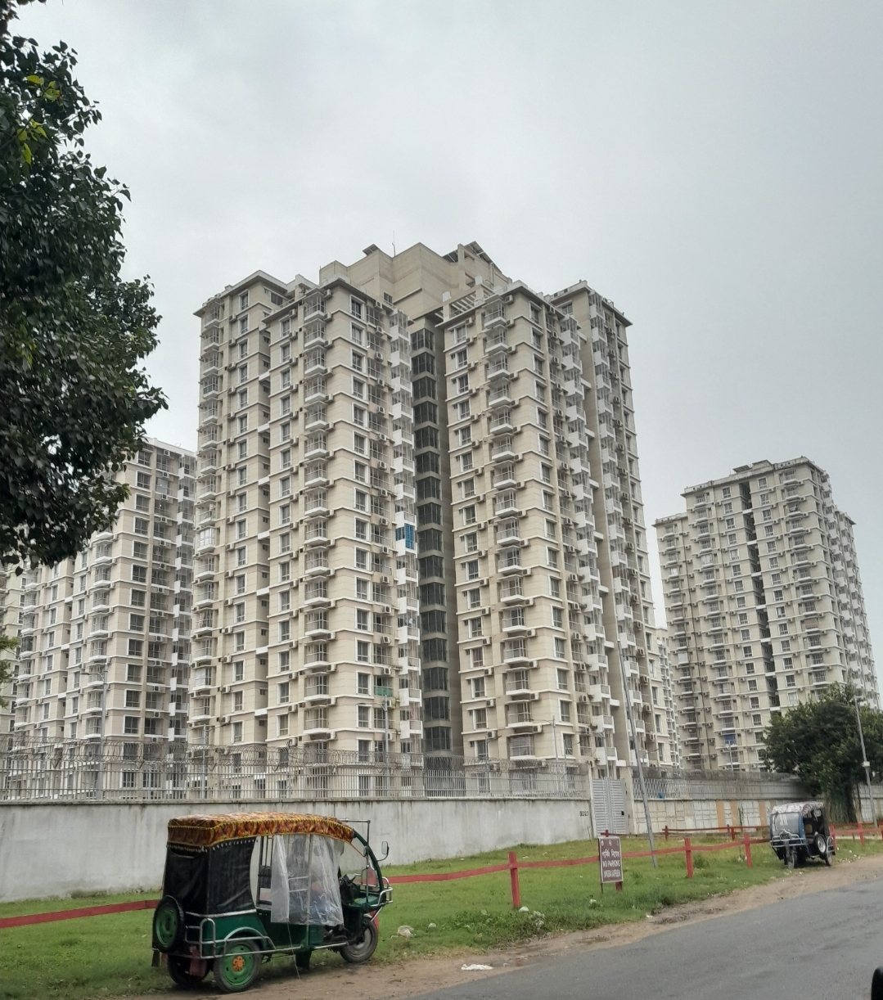
Ecological Impacts Societal Impacts
1. Water Ecosystems 1. Economic Development
2. Thermal Pollution 2. Community Displacement

Slide 9

Health Impacts
1. Radiation Exposure
2. Public Health Infrastructure
Wildlife Impacts
1. Habitat Loss 2. Migration Patterns

Slide 10
Recommendation
1. Water Resource Management and Thermal Pollution Control
2. Radioactive Waste Management
3. Air Quality Protection
4. Biodiversity and Ecosystem Conservation
5. Flood Risk Management
6. Community Health and Safety
7. Continuous Monitoring and Auditing
8. Sustainable Energy Practices

Slide 11
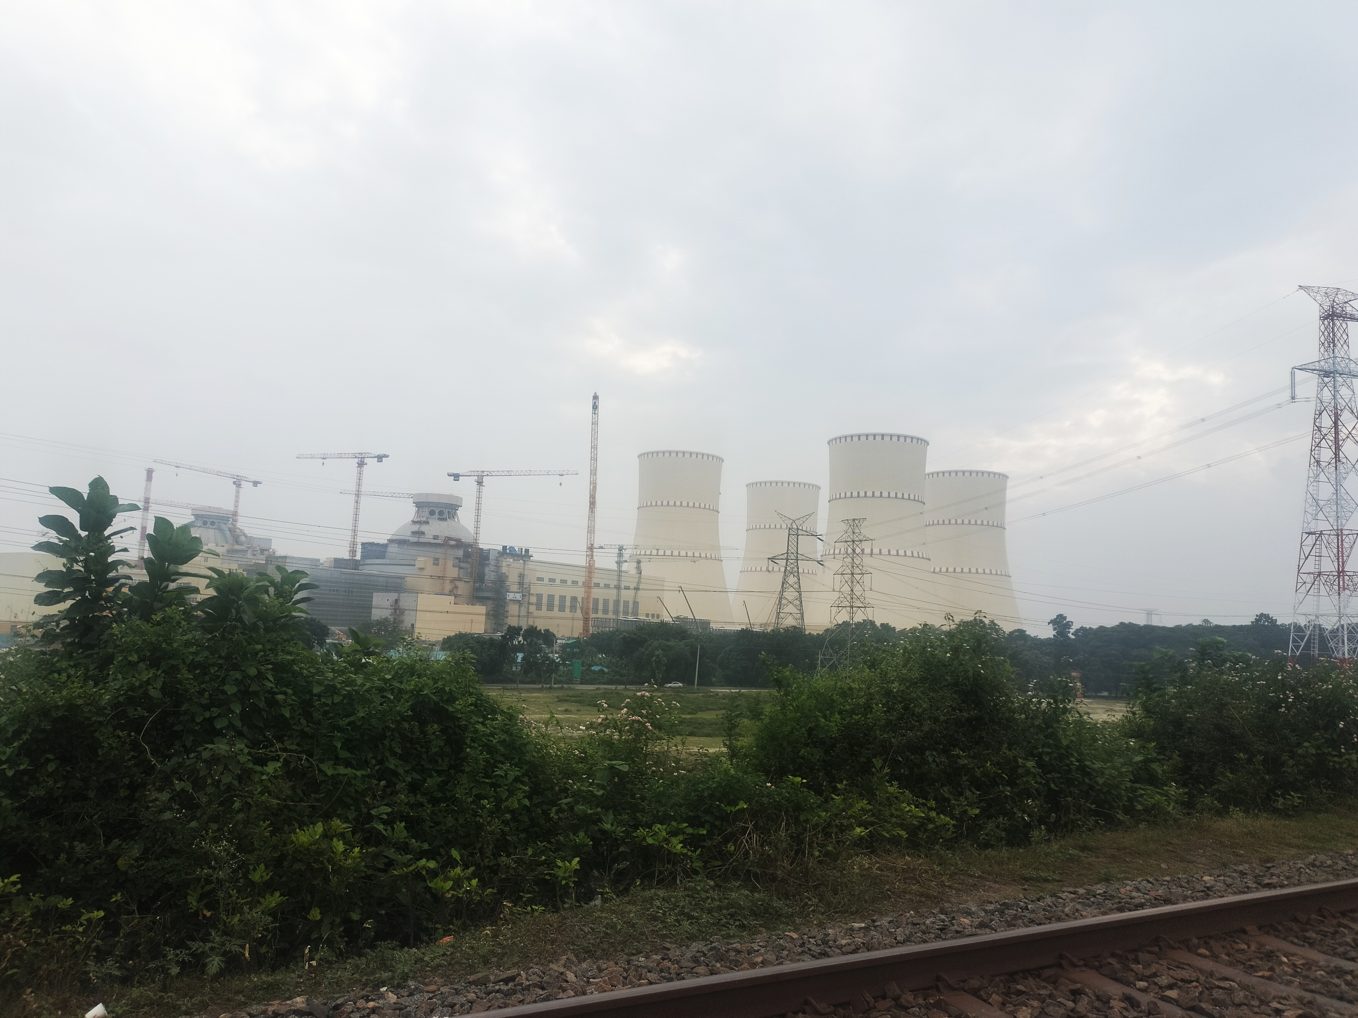
Thank You

